Slide 1


CHALLENGES BECAME OPPORTUNITIES
Creating the New KYTC
SUE Schema
for Digital Delivery
Phase I Development
KYTC Utilities & Rails | SW SUE Partnership
Notes:
Pat: Today we are introducing more than a new spreadsheet. We are developing a structured SUE data schema that allows utility information to remain useful and accessible from early investigation through design and construction.

Slide 2













MEET OUR TEAM
Lauren Meighan, PE
D7 Design Engineer Supervisor
Ben Shinabery, PLS
Qk4 SW SUE Lead
Emily Eising, PE
D6 District Utility Supervisor
Steve Holliger
Qk4 SW SUE/Survey Lead
Pat Eckert
CO GIS Analyst III
Corey Napier
JMT SW SUE Lead
Additional questions? Scan a team member’s QR code to connect directly by email
Notes:
Pat: Very brief because we have already been introduced by the moderator.

Slide 3
DIGITAL SUE DELIVERY
A static deliverable supports a digital project, but limits the value of the data
The new schema changes SW SUE from a document handoff into a reusable data lifecycle
STATIC SUE
DYNAMIC SUE
A drawing, dgn, spreadsheet, etc. is delivered.
The data stops moving.
Manual re-entry between systems
Context separated from geometry
Repeated post-processing
Project knowledge fades after delivery
One structured dataset continues to work
Standard fields and controlled values
  Think KYTC surveyor’s coded data
Automated warning checks on raw data
Standard forms from 1st submittal through letting. Contractors know what to expect.
GIS, CADD, models, and construction views
Less post-processing at every handoff
Notes:
Pat: A static deliverable supports a digital project, but it limits the continuing value of the data. The schema allows one structured dataset to support multiple deliverables, reducing manual re-entry, repeated processing, and the potential loss of information between project phase.

Slide 4


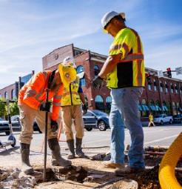
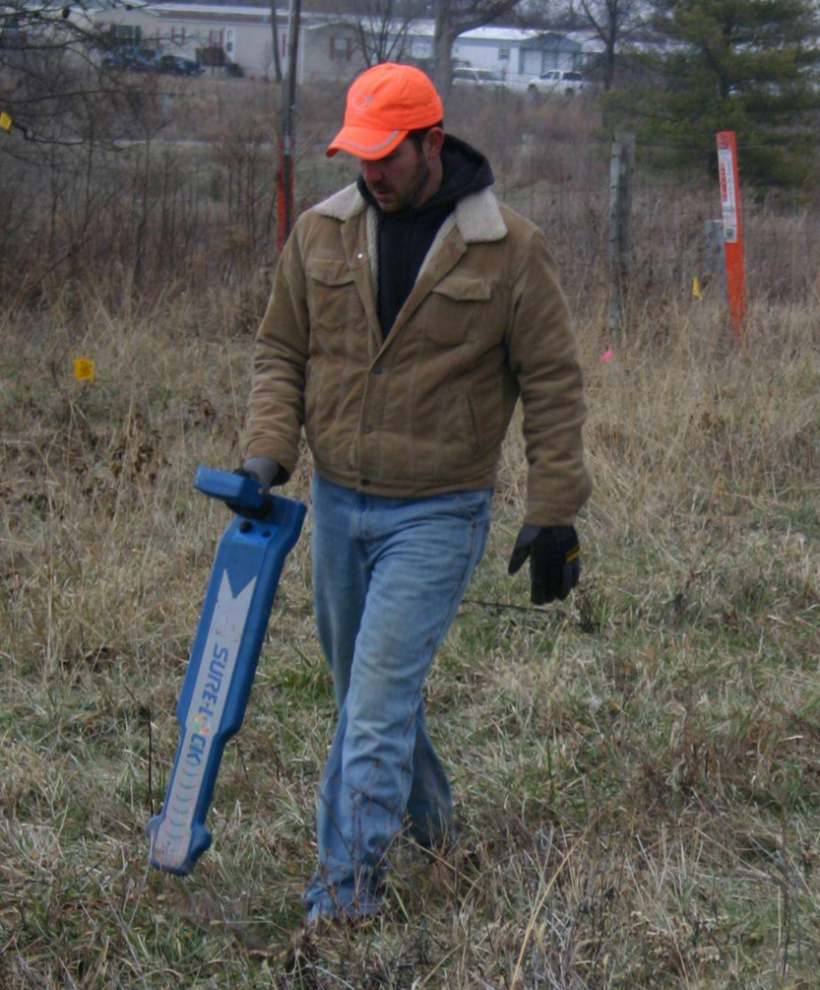
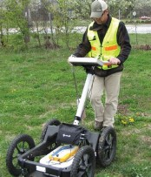
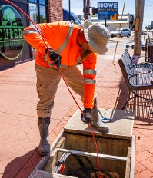
COLLABORATIVE INNOVATION
FROM COLLABORATION TO STANDARDIZATION
Statewide Innovation
Early Collaboration
District Leadership Lauren & Emily
District engineers embraced a new QL-B-first strategy, shifting SUE toward earlier design coordination and creating a more complete digital utility footprint.
Standardized Workflow
JMT & Qk4
Statewide consultants adopted a common field collection workflow and standardized SUE deliverables, improving consistency across projects.
Digital Delivery
The Outcome
Standardized SUE data can now be validated, integrated into KYTC’s GIS schema under development, and reused throughout design, construction, and future digital delivery initiatives.
Continuous Improvement
KYTC + Consultants
Field feedback drove development of one FXL file, spreadsheet automation, and QA/QC automated validation tools of raw SUE data, reducing manual effort and improving data quality.
DISCOVERY EARLY: Capture Once Validate Raw Data Automatically Communicate Forward
Notes:
Lauren/Corey: Our project experience revealed the need for consistent fields, terminology, and delivery expectations. The schema applies those lessons in a repeatable way while preserving room for project-specific findings, professional judgment, and field conditions that cannot be represented by standard codes alone.

Slide 5



SUE Team’s Coordination and Partnership
KYTC Central Office – Establish the statewide process, standards, consistency, and accountability for how SUE and utility conflicts are managed and also charged with developing a program to house data for future use. “Big Picture”
KYTC District offices – Apply the process to the specific project, understand local utility conditions, and coordinate the project through design and construction. “Project Level Owner”
Design Team – Use the SUE information to make design decisions that avoid, minimize, or properly address utility conflicts
Construction Team - The contractor brings a completely different perspective. The designer sees the project as a design problem; the contractor sees it as a construction sequence and risk problem. (i.e. shoring, haul roads, unknown utilities, etc.)
Notes:
Lauren/Corey: The schema was not developed by one discipline working independently. It grew through coordination among KYTC, the Districts, and our SUE consultants. Each project helped us better understand what information the different project partners need and how that information should move forward.

Slide 6
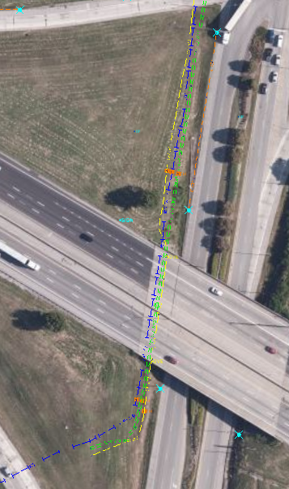
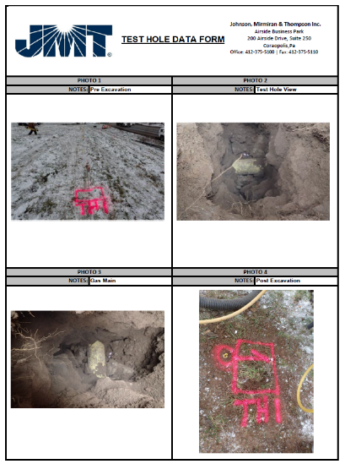
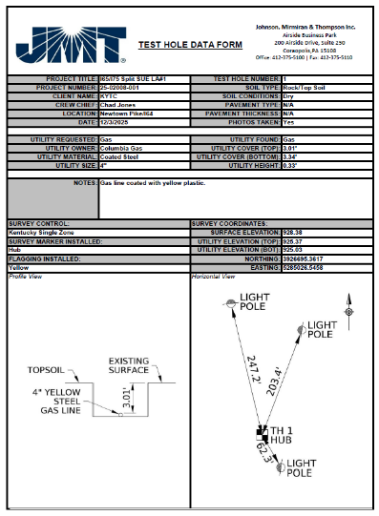
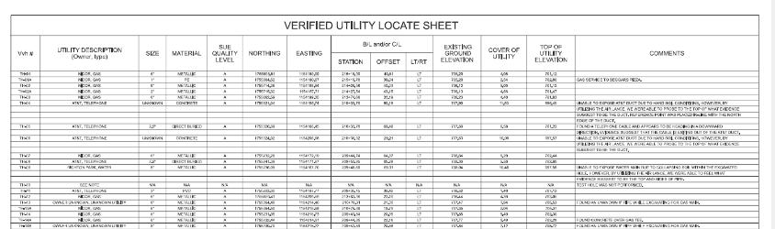


Deliverables - “Data is King”
KMZs
DGNs
  Plan view
  Verified Utility Locate Sheet
  Utility Certification Note
An excel-based database structured around a standard data schema (data integrates into GIS/ORD/etc.
Test Hole Form
Notes:
Lauren/Corey: Traditional SUE deliverables remain important, but the lasting value is the data behind them. Reports, drawings, maps, and plan sheets should be different views of the same verified information, not separate products requiring repeated interpretation and post-processing.

Slide 7
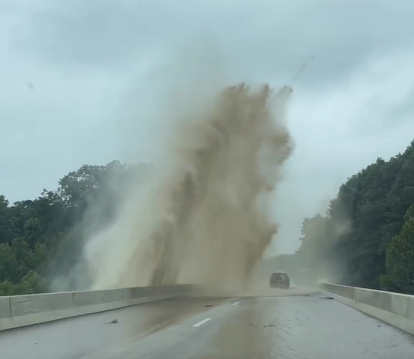


SUE Cost Benefits & SUE Quality Levels
Purdue & Penn State conducted studies that determined on average $4.62 is saved for every $1.00 spent on QLA and QLB utility information.
The Quality Level of SUE performed depends on the level of accountability, liability, and risk the designer or project owner is willing to accept for the project with respect to underground utilities.
Understanding the different SUE Quality Levels saves money.
Quality Level D – Utility records
Quality Level C – QLD plus survey
Quality Level B – Utility Designation
Quality Level A – Utility Locating (Test Holes)
ASCE 38-22 requires utility quality levels to be assigned and sealed by a qualified licensed professional in accordance with applicable state law.
Notes:
Lauren/Corey: A quality level communicates how the utility information was developed and the degree of confidence behind it. Applying the appropriate quality level early helps the project team focus resources where uncertainty creates the greatest risk. Under ASCE 38-22, quality levels are documented under the seal of a qualified licensed professional in accordance with applicable state law.

Slide 8

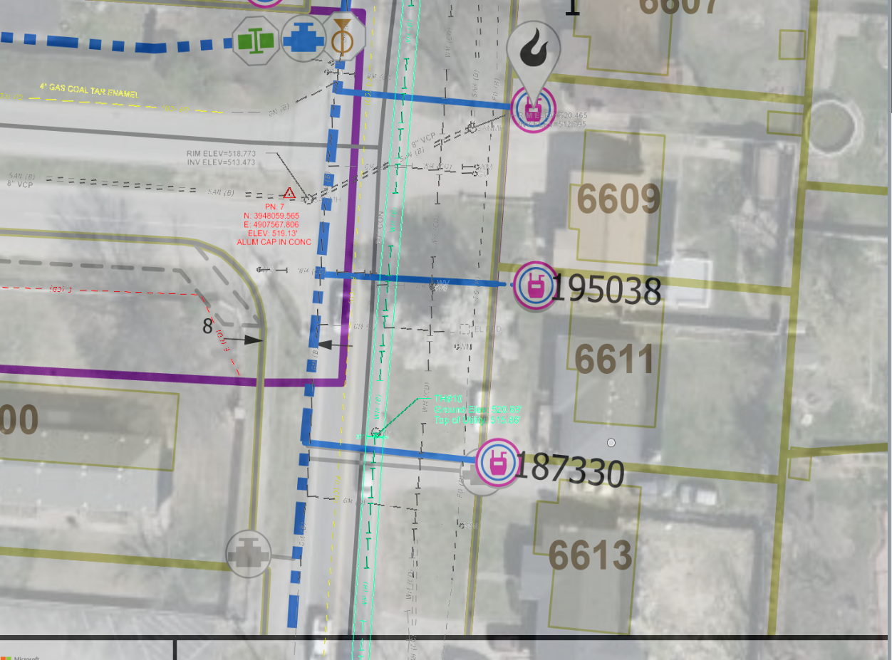

What is the purpose of KY811?
Changing the expectations of the engineering community toward the purpose of KY 811 BUD calls…
Design Ticket – Mapping Data
Dig Ticket – Construction Safety
Notes:
Emily/Ben/Steve: The design ticket is more than a request or utility markings. It BEGINS the process of gathering information that can support planning and mapping data. When that information is structured from the beginning, it can become part of the documented SUE digital dataset rather than remaining a one-time static data via the paint markings in the field.

Slide 9

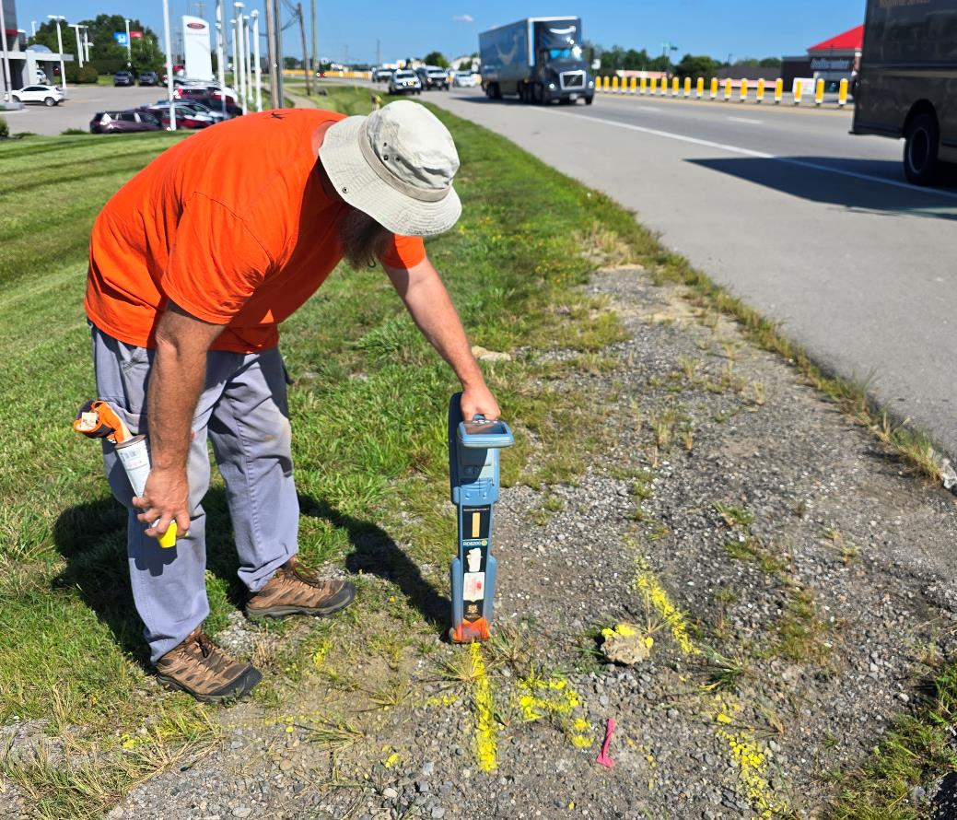
Start the Utility Investigation Early
Planning & Development
Phase I – Conceptual Design
Environmental Documentation
Preliminary Design – Survey Utilities
Final Design – 3D Modeling
Right-of-Way Acquisition
Utility Coordination & Relocation
Letting to Construction
Closeout & Maintenance
Notes:
Emily/Ben/Steve: Utility information creates the greatest value when it is available while planning & design choices are still open. Beginning early allows the team to identify risk, determine where higher quality levels are needed, and use verified information to influence the plans/design before conflicts become expensive changes.

Slide 10
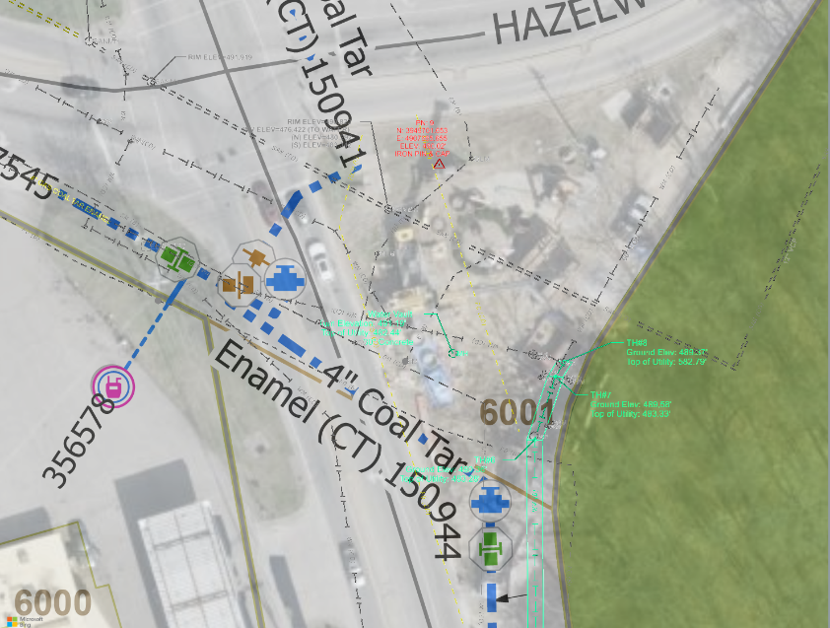
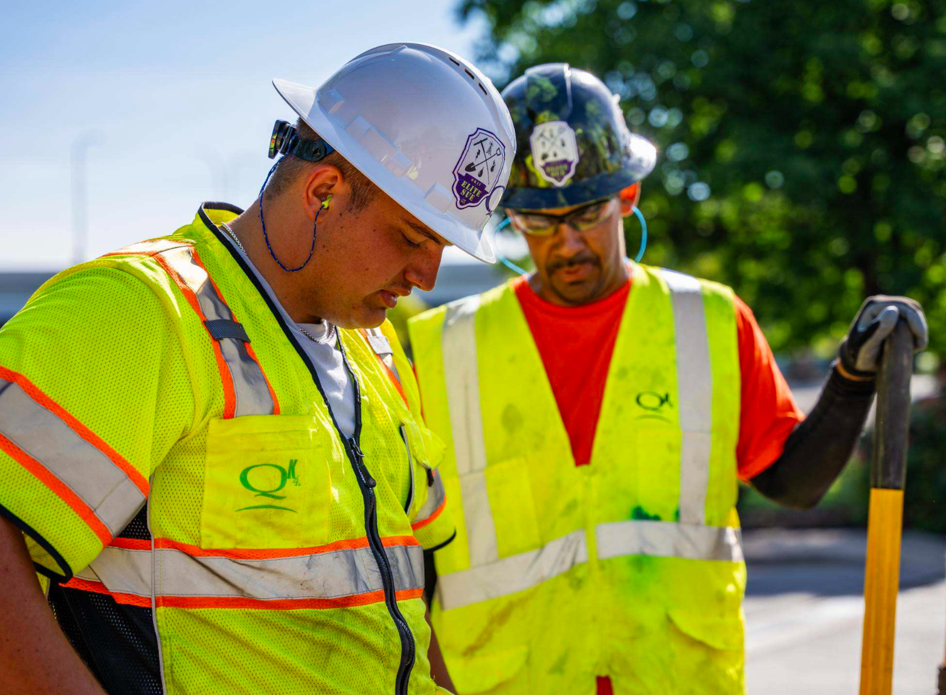

A More Sophisticated Data Collection
Survey field crews now have all the tools they need to locate, survey, code, annotate, store and visualize data in the field while they find, dig, and locate subsurface utilities.
Office technicians do not need to spend the time to manually update files after field location creating efficiency of data processing for all utility metadata.
Notes:
Emily/Ben/Steve: Modern field technology allows the crew to collect more than a utility’s horizontal & vertical position. Various custom attribute data can be collected from field observations while the utility is visible, reducing the need to interpret or reconstruct that information later, then entered in various systems downstream.

Slide 11
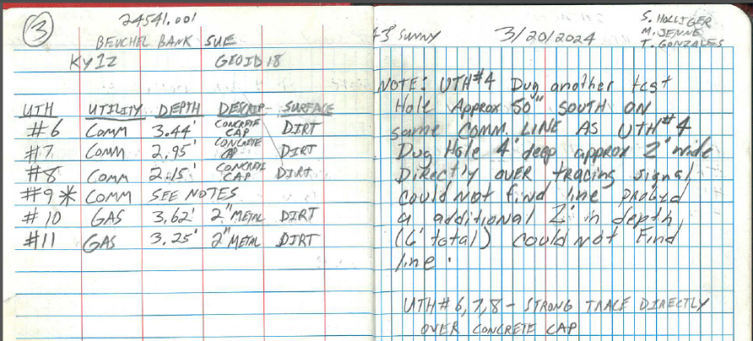
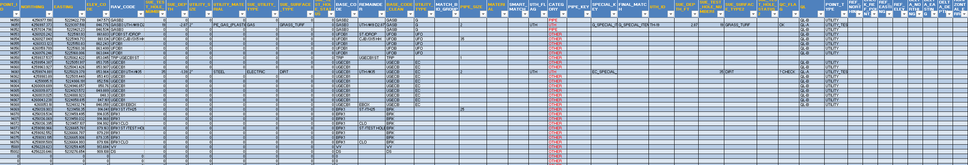


Coding the Data…
Automated processes take time to develop and like a newborn baby may have some stumbles at first…
Then they start to walk, run, sprint, win…
Notes:
Emily/Ben/Steve: Controlled fields and standards values make the raw data consistent and reusable.

Slide 12
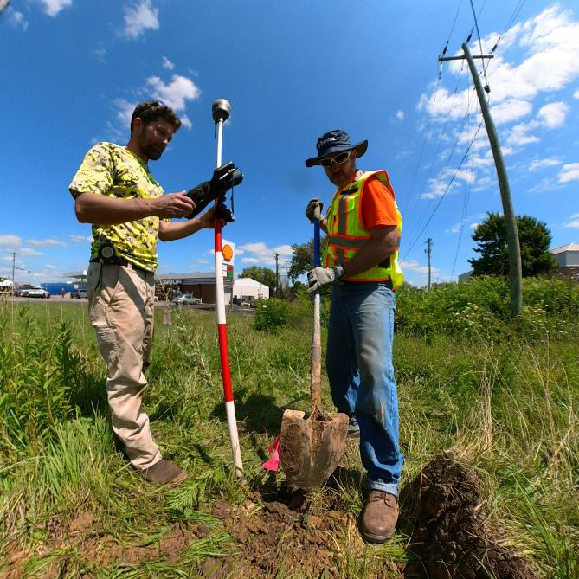
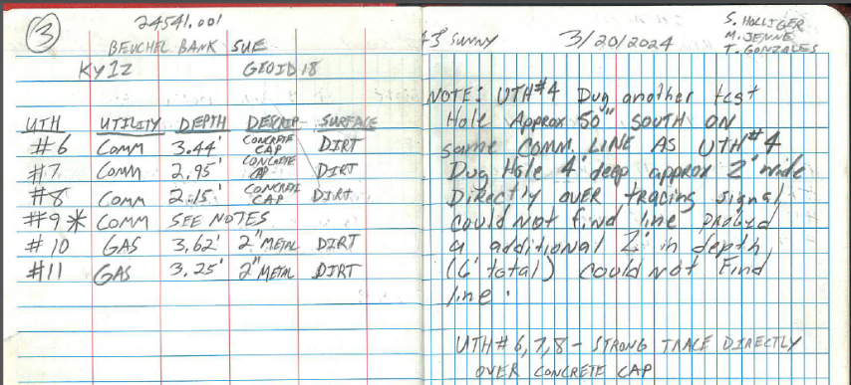
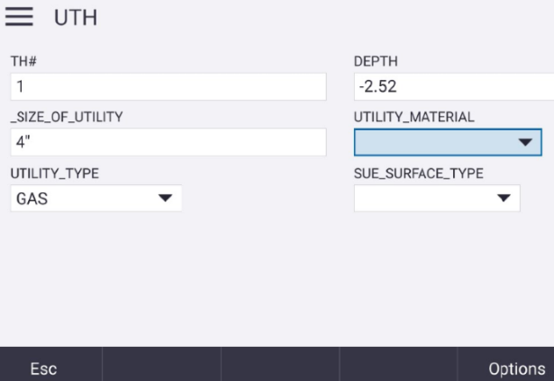
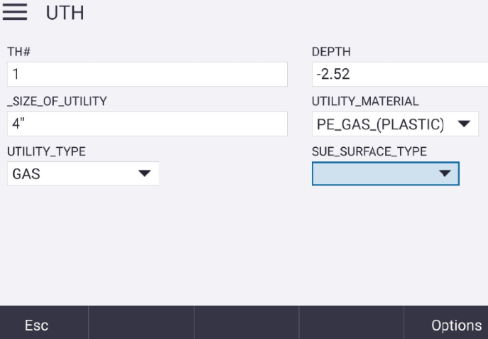
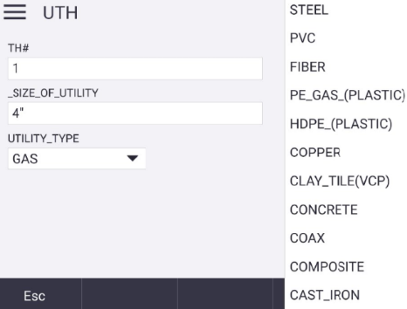
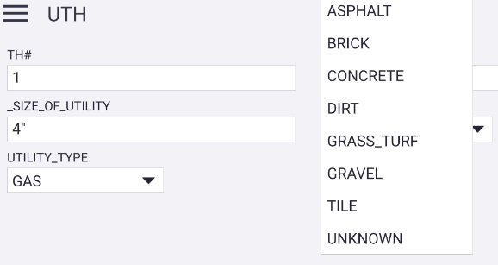
A More Sophisticated Data Collection
The work no longer stops at locating a utility. Field crews can capture its position, attributes, field conditions, and supporting notes directly within the data collector, while the structured data schema transforms each discovery into reusable project data.
Notes:
Emily/Ben/Steve: The work no longer stops at locating a utility. Field crews can capture its position, attributes, field conditions, and supporting notes directly within the data collector, while the structured data schema transforms each discovery into reusable project data.

Slide 13
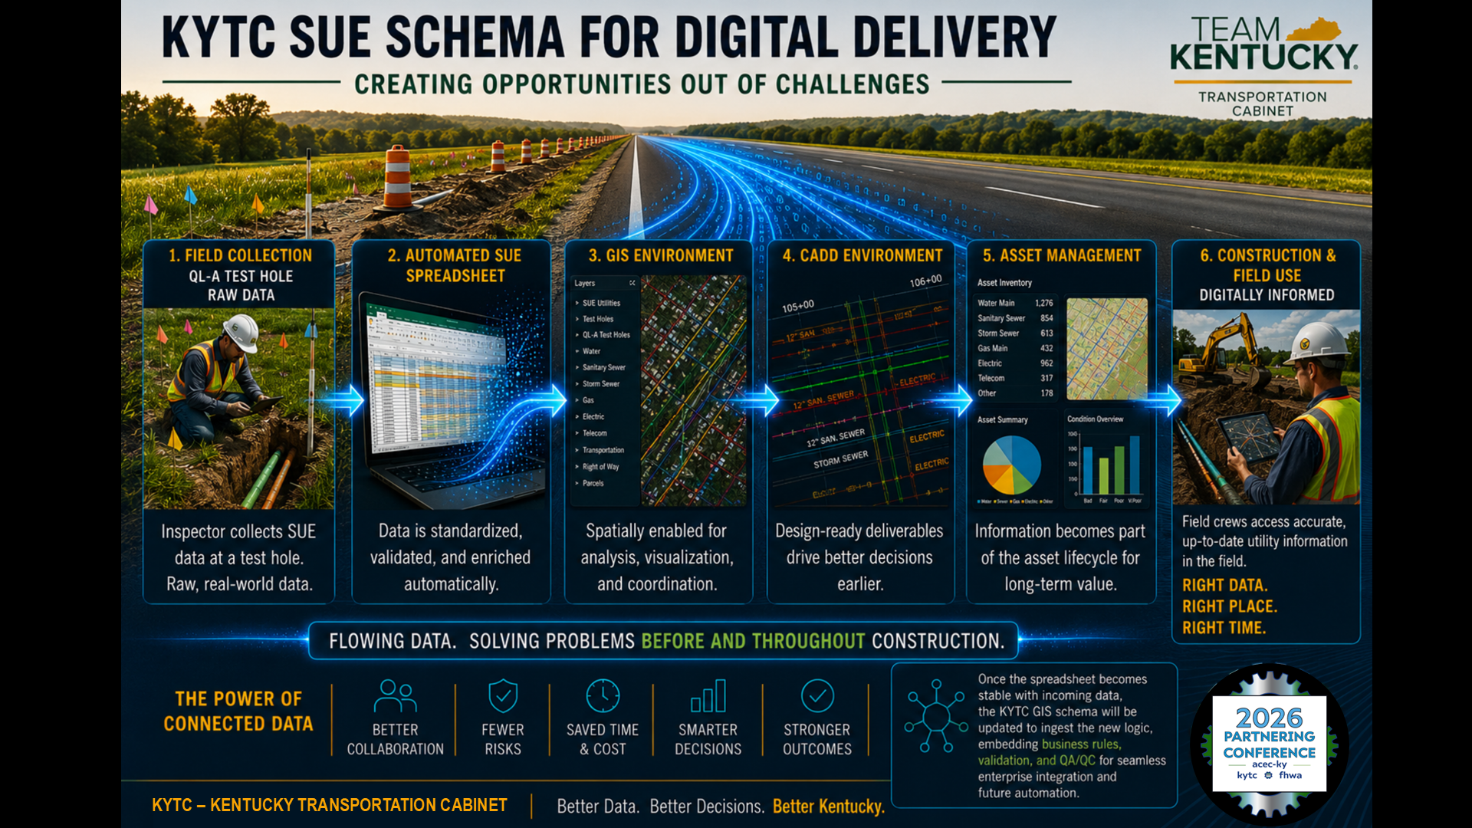
KENTUCKY TRANSPORTATION CABINET
Notes:
Pat: This brings the complete process together. We discover early, capture information once, validate the raw data, and communicate the verified information forward. The digital data becomes the common source supporting GIS, CADD, plan sheets, construction, and future project use.

Slide 14
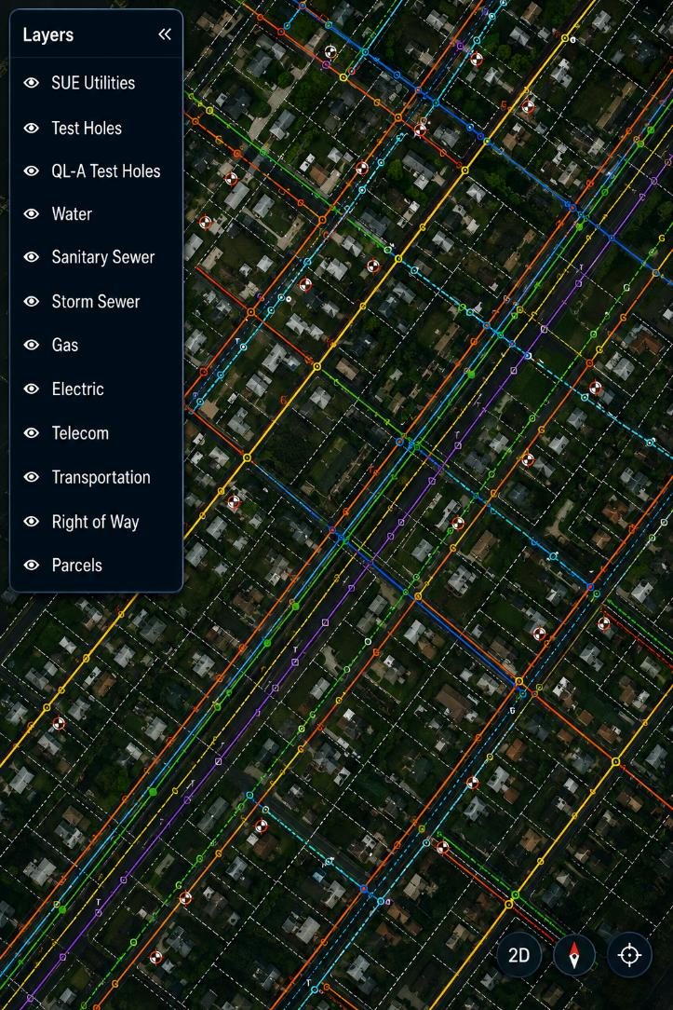
KYTC SUE Schema
for GIS Digital Delivery
(With Updated GIS Schema)
Once the standardized SUE spreadsheet produces consistent statewide data, KYTC’s GIS schema will be updated to ingest the enhanced logic, supporting automated validation, visualization, and future digital delivery workflows.
This set of tools will determine workflows of what KYTC requires from automated SUE data; from the 1st submittal of SUE results to construction. The ultimate goal would be to have the automation and templates in a system that allows you to upload a SUE csv file.
Notes:
Pat: Because the information is structured, it can update GIS without rebuilding the dataset for every use. The same utility features and attributes can support mapping, analysis, coordination, and future updates while preserving their relationship to the original SUE investigation.

Slide 15
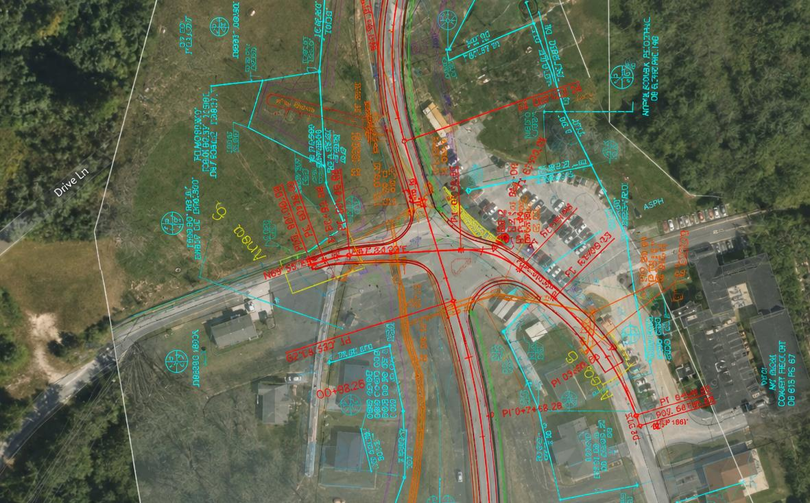
KYTC SUE Schema for CADD Digital Delivery
(With Updated GIS Schema)
This automation didn’t happen overnight. It came directly from feedback and collaboration with our SW SUE consultants. As each SUE project was completed, we learned something new, refined the workflow, and made the process better.
That’s really the story we would like to present here today.
Notes:
Pat: The same structured data can also support the CADD environment similar to how KYTC’s surveyors support the ORD environment today. Designers receive utility geometry and attributes in a usable form, reducing manual translation and allowing utility information to participate more directly in design & utility coordination and conflict evaluation throughout the project lifecycle.

Slide 16
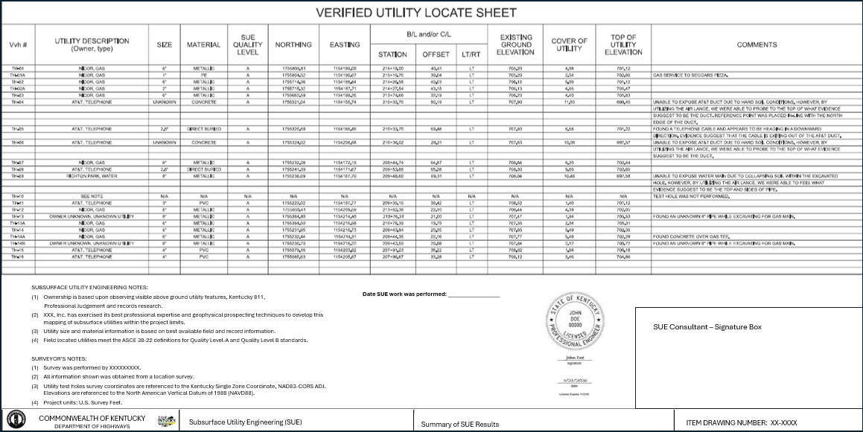

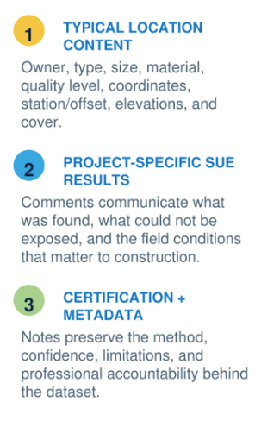

KYTC SUE Schema Flows Into Plan Sets
(Draft - Under Development)
Notes:
Pat: Although this plan sheet is under development and considered for review only, it can be an essential construction deliverable standard. SUE data is of high quality and there is an associated upfront cost for the work, the SW SUE data should be consistently communicated to construction. IF THERE IS TIME, SHOW THE ACTUAL EXCEL SPREADSHEET, IMPORTING CSV (BEFORE AND AFTER). If there is not enough time, skip the spreadsheet.

Slide 17
MEET OUR TEAM
Questions?
Lauren Meighan, PE
D7 Design Engineer Supervisor
Ben Shinabery, PLS
Qk4 SW SUE Lead
Emily Eising, PE
D6 District Utility Supervisor
Steve Holliger
Qk4 SW SUE/Survey Lead
Pat Eckert
CO GIS Analyst III
Corey Napier
JMT SW SUE Lead
Additional questions? Scan a team member’s QR code to connect directly by email
Notes:
We welcome your questions.

